Slide 1

PCA Analysis For NCI60 Data
By Adithya Prahasith

Slide 2
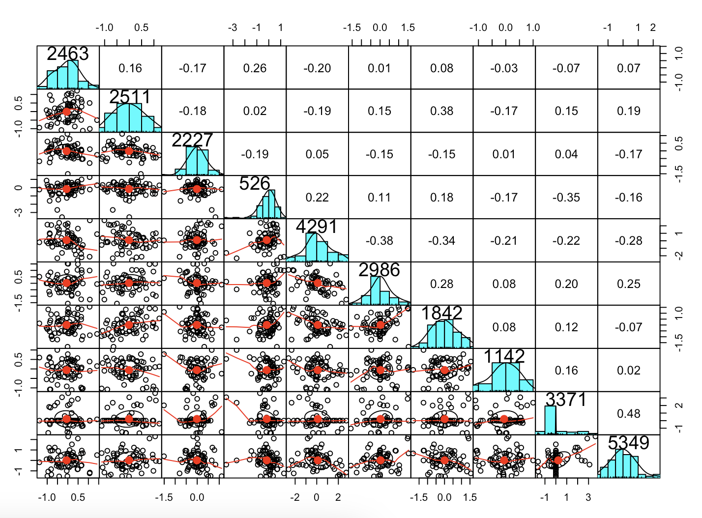
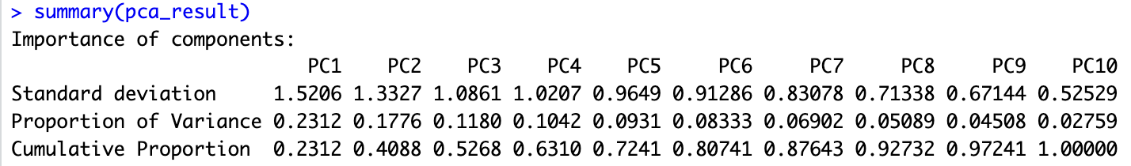
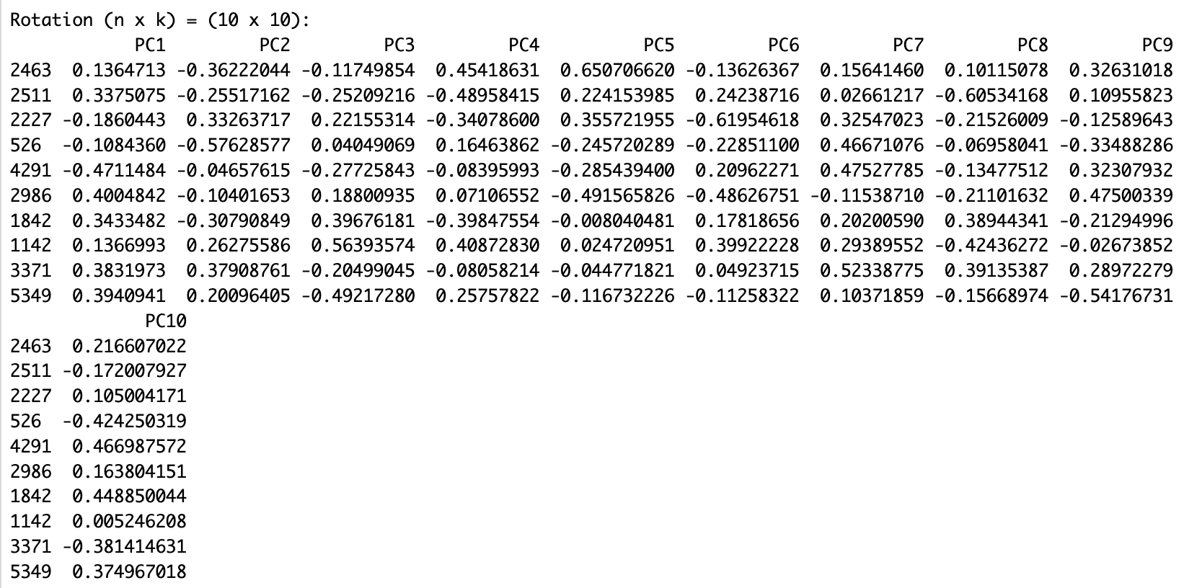
Initial Overview & PCA Insights
6830 genes from 64 cancer cell lines. Cancer type is also recorded.

Slide 3
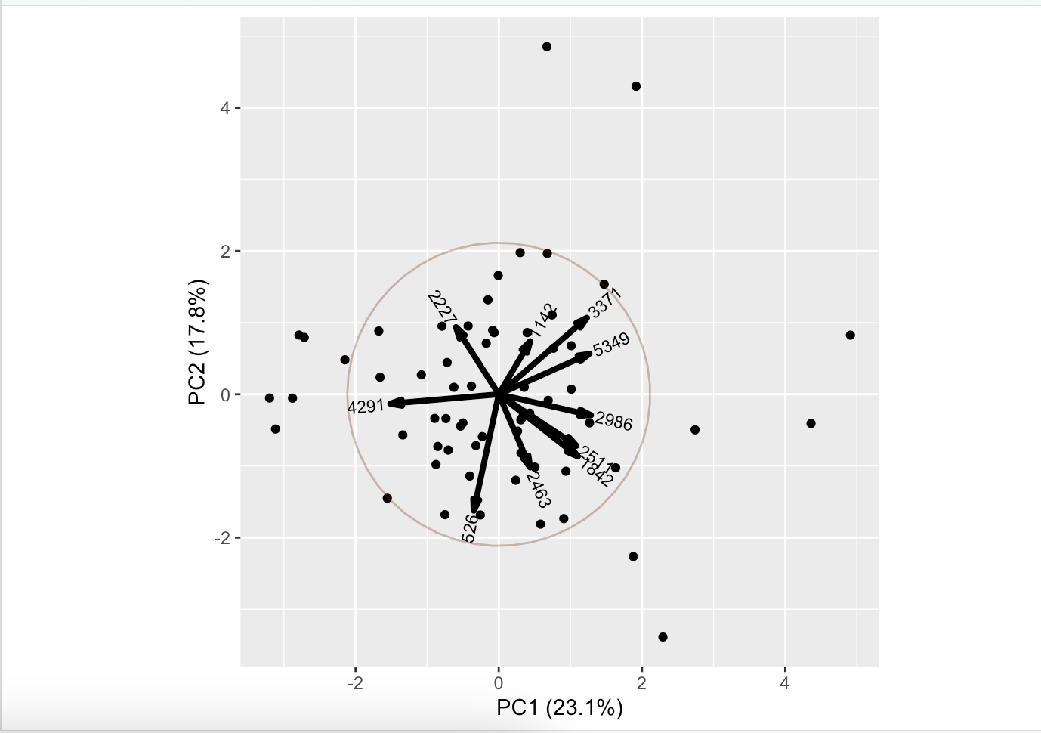
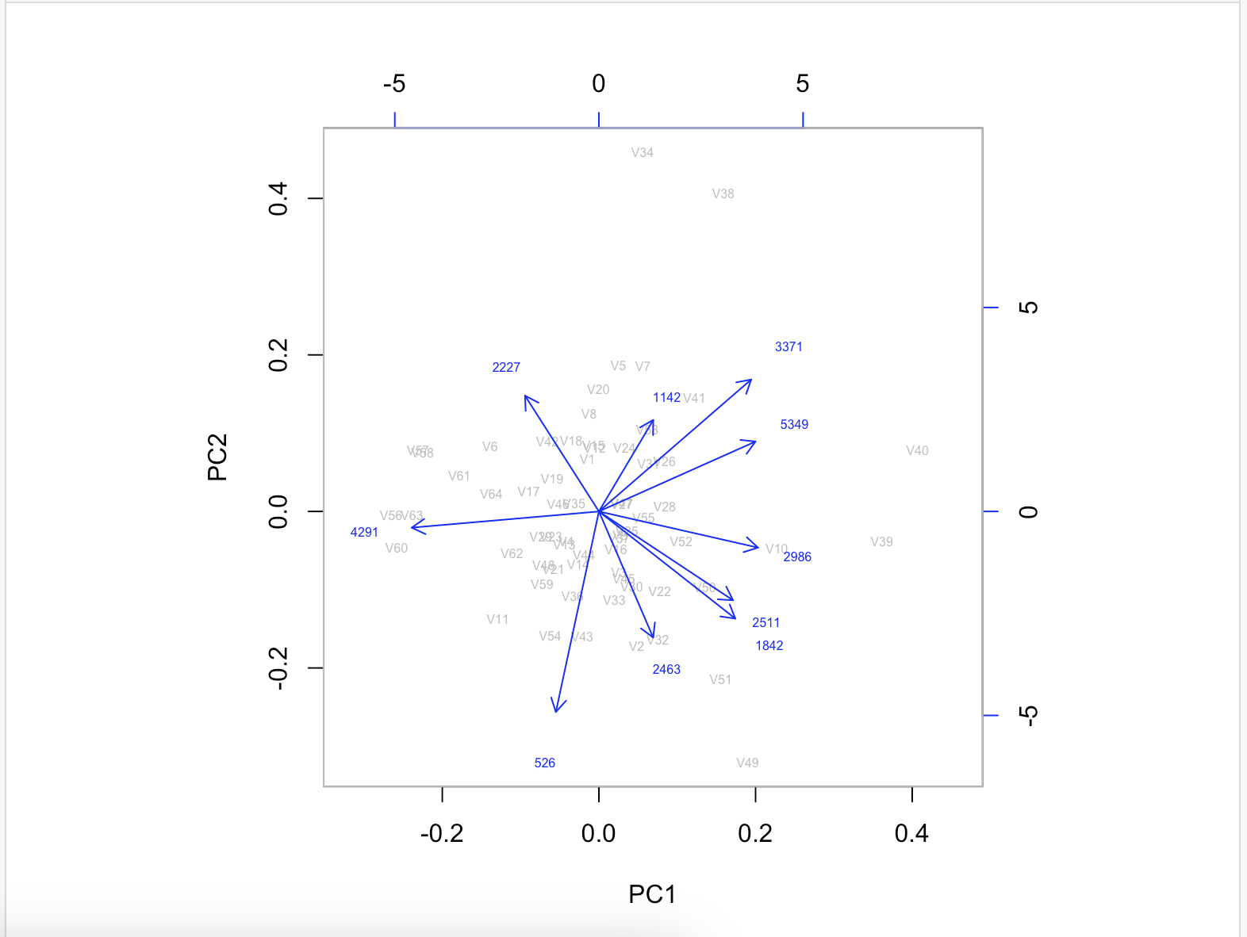
Bi Plot- PC’s For Random Sample Genes
PC1 - 23% of variance, PC2-17.6%

Slide 4
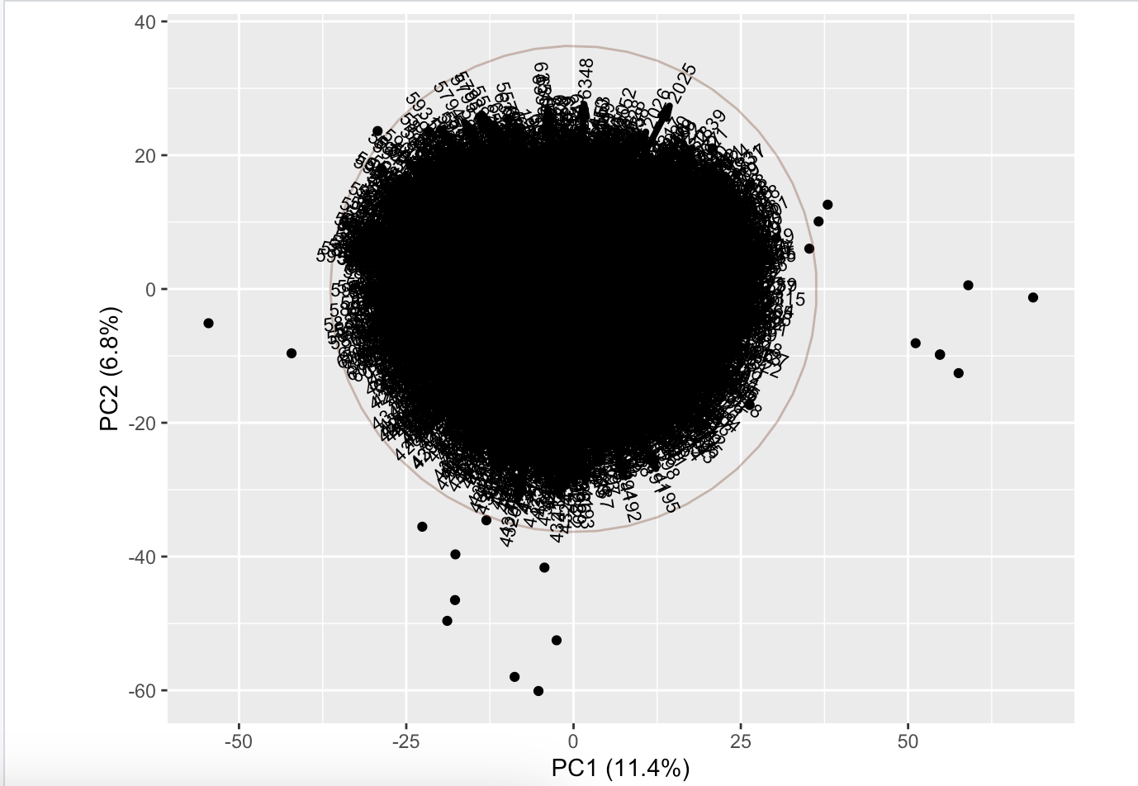
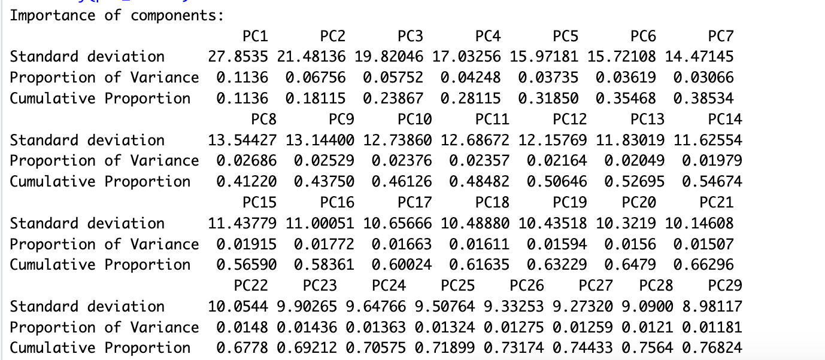
Bi Plot - PC Components All 64 Genes
PC1 - 11% of variance, PC2-6.8%

